Slide 1
Metadata [Standards]
EDS213 - Databases & Data Management
Renata Curty
Research Data Services, UCSB Library
recurty@ucsb.edu

Slide 2
Learning Objectives
Understand the role of metadata standards in facilitating the management, discovery, interoperability, and reuse of digital resources and research data.
Recognize the importance of adhering to domain-specific metadata standards and determining which standard should be used.
Identify metadata standards commonly used in Earth and Environmental Sciences research.

Slide 3
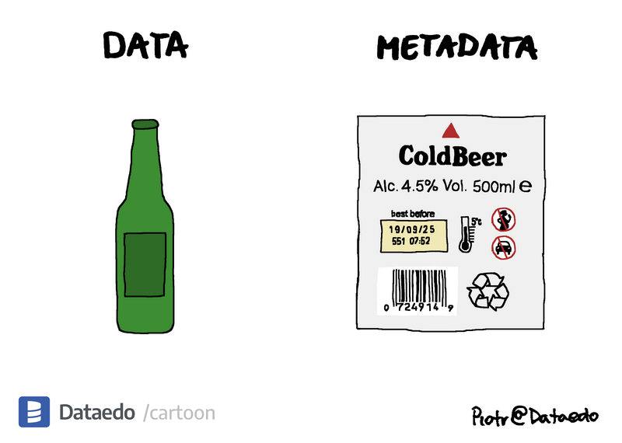
Metadata
Data about Data
Descriptors that help understanding what data are, where to find them, how to access them, right to use, and more.

Slide 4
Minimize Ambiguity & Assumptions
98°F
What temperature? Measured how? Under what conditions?
“The surface temperature is 98°F, measured using an infrared thermopile sensor (model XYZ-IR5), mounted 3 meters above ground level, capturing data every 10 seconds. The sensor was last calibrated 3 months ago, has a known accuracy of ±0.05°F, and has been operating in an outdoor environment under partial shade for 72 hours.”
Pasquetto, I. V., Borgman, C. L., & Wofford, M. F. (2019). Uses and Reuses of Scientific Data: The Data Creators’ Advantage. Harvard Data Science Review, 1(2). https://doi.org/10.1162/99608f92.fc14bf2d

Slide 5
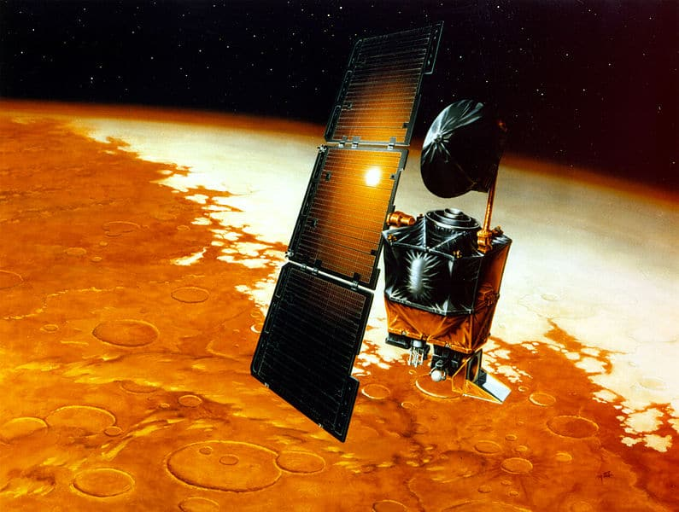
Prevent Disasters
Stewart, J. (2002, October 1). Mars Orbiter disaster – A failure of data management. TDAN.com. https://tdan.com/mars-orbiter-disaster-a-failure-of-data-management/5128
Imperial or metric system?
Miscalculation of the orbiter's trajectory
~190 million USD loss

Slide 6
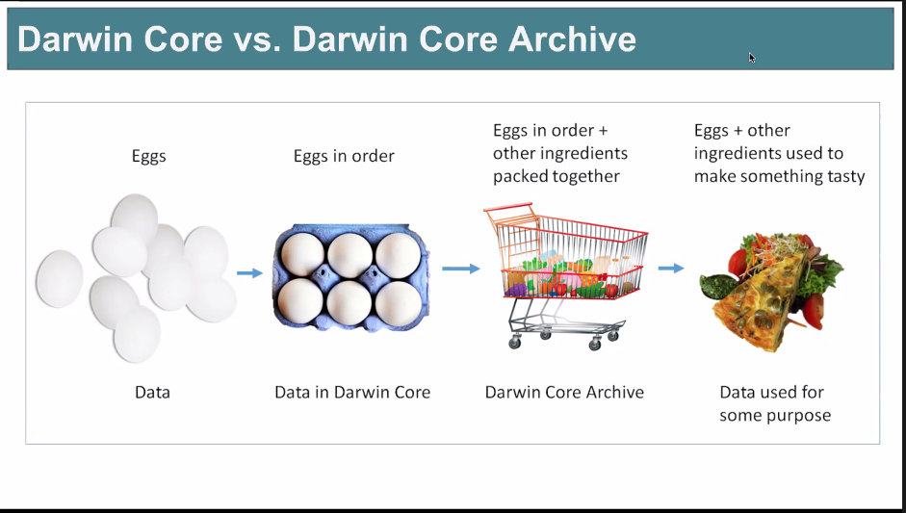
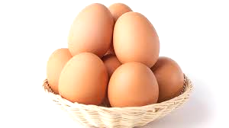
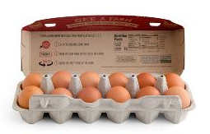
Allow for New Research
Facilitates cross-disciplinary collaboration and partnerships
Enhanced metadata boosts reusability and enables new research outputs
Arranged, labelled and with provenance info (traceable)
Other related items packed together
You may combine them to make something tasty
Data + Rich Metadata
Data Repository
(Software/Code + Documentation
New Research Deliverables
Data

Slide 7
Study Level Metadata
+
Data/File Level Metadata
Contextual Information: research question, goals, methodology, and overall design of the study.
Provenance: details about the data's origin, including who collected it, when, and how.
Ethical Considerations: information about any ethical protocols and approvals related to the study.
Data Description: information about the specific variables, data types, and formats used in the study.
Data Quality: details about the accuracy, reliability, and completeness of the data.
Data Structure: describes the organization and arrangement of the data, including file formats and data dictionaries.
Access and Usage: information about data access restrictions, licenses, and permitted uses.

Slide 8
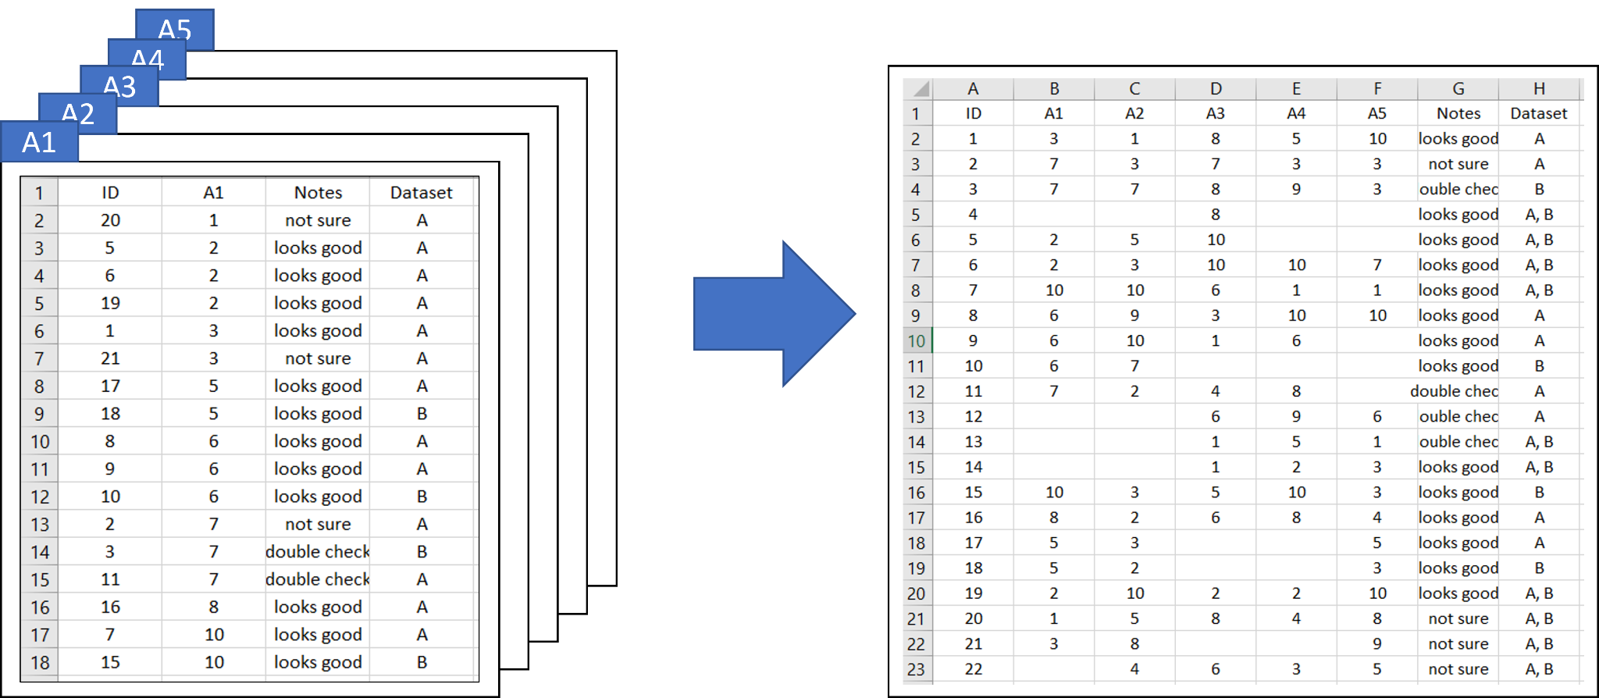

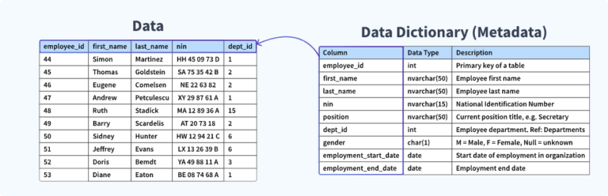
Store basic metadata at the file level for better portability and easy interpretability.
Do not use colors or other formatting to convey meaning
Include a README file to describe multiple files and how they relate to each other.
Choose to share your data in a repository that maintain rich queryable metadata.

Slide 9
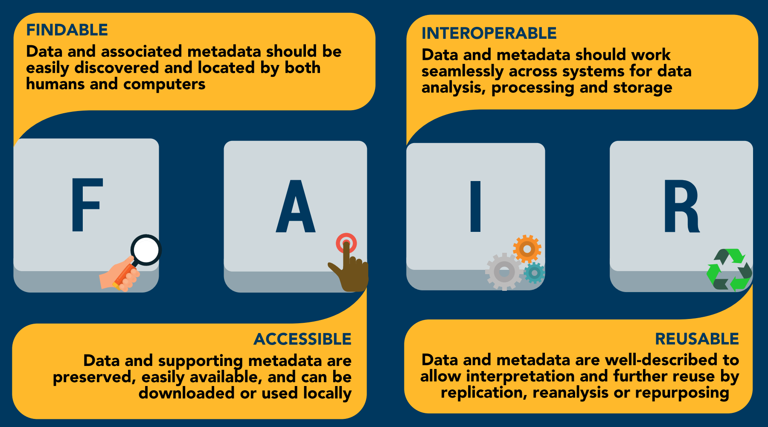
FAIR Data, Requires Metadata!
Wilkinson, M. D., Dumontier, M., Aalbersberg, I. J., Appleton, G., Axton, M., Baak, A., Blomberg, N., Boiten, J. W., da Silva Santos, L. B., Bourne, P. E., Bouwman, J., Brookes, A. J., Clark, T., Crosas, M., Dillo, I., Dumon, O., Edmunds, S., Evelo, C. T., Finkers, R., Gonzalez-Beltran, A., … Mons, B. (2016). The FAIR Guiding Principles for scientific data management and stewardship. Scientific data, 3, 160018. https://doi.org/10.1038/sdata.2016.18

Slide 10
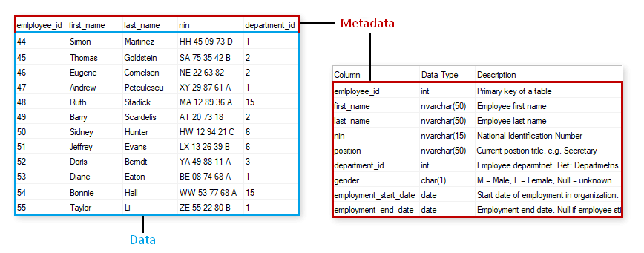
Metadata?
Metadata
Data

Slide 11
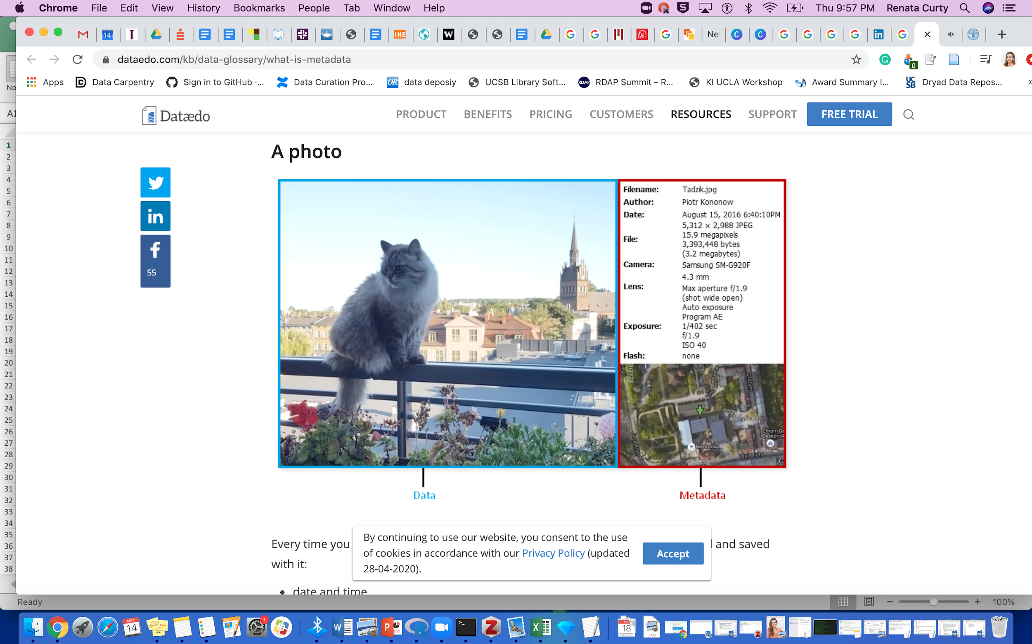
Metadata?
Metadata
Data

Slide 12
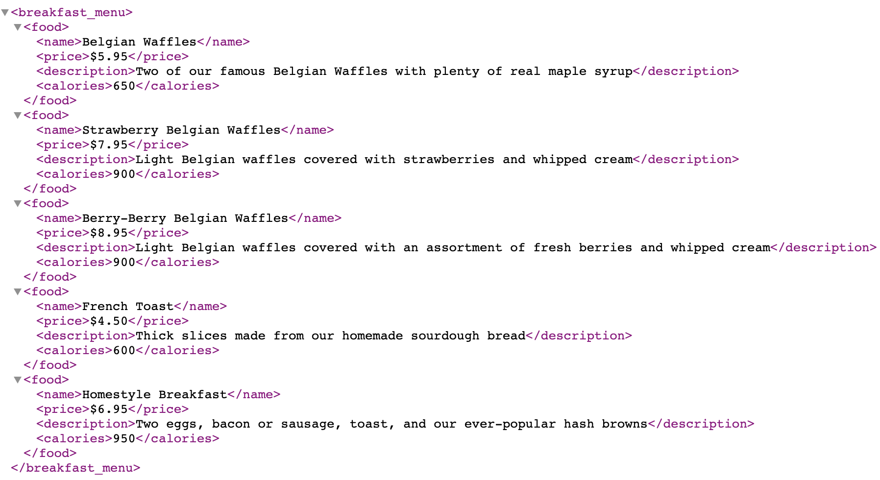
Metadata?
Data
Metadata

Slide 13
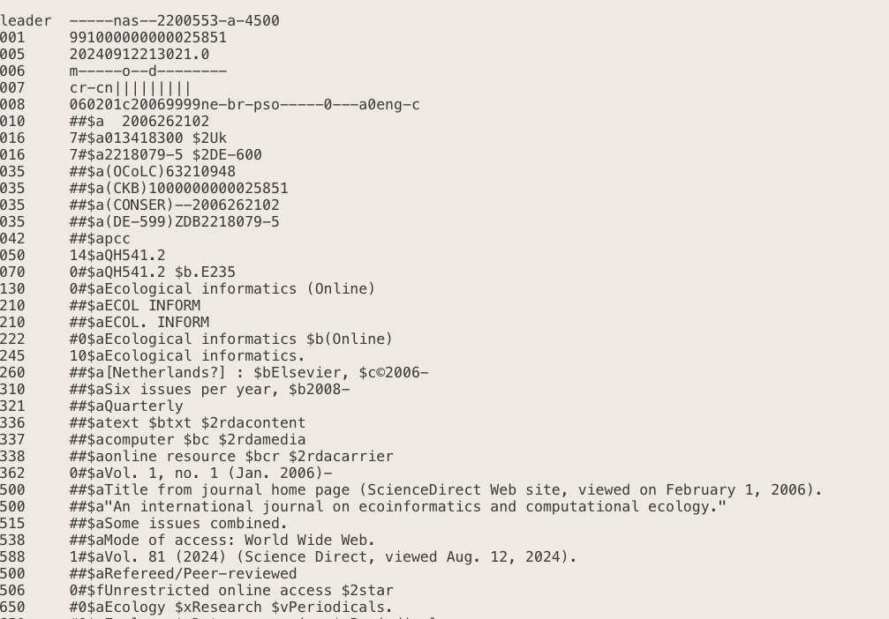
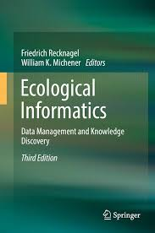
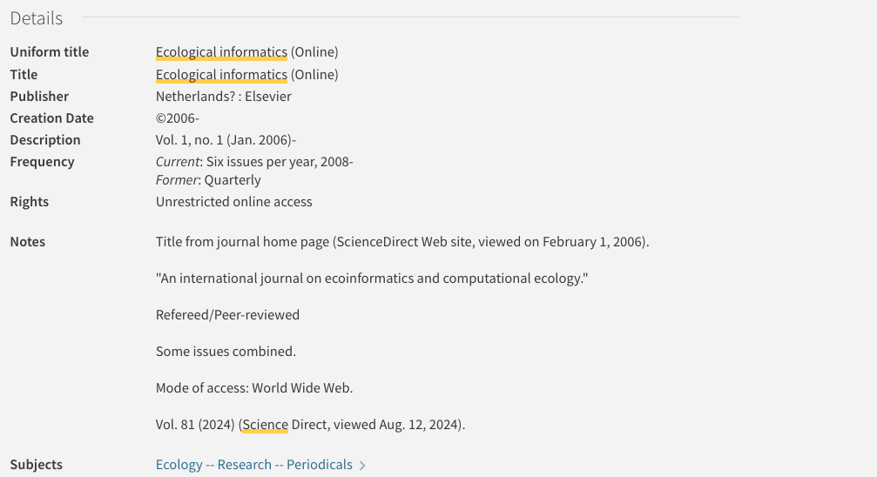
Metadata?
Metadata

Slide 14
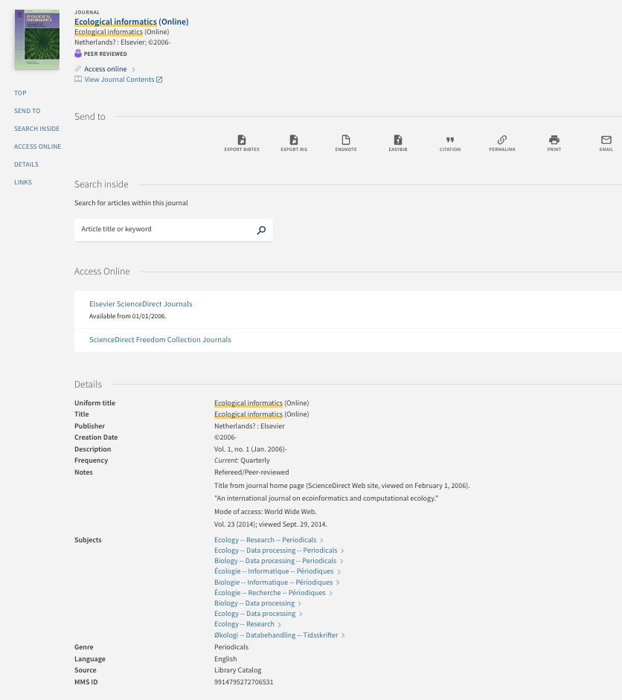
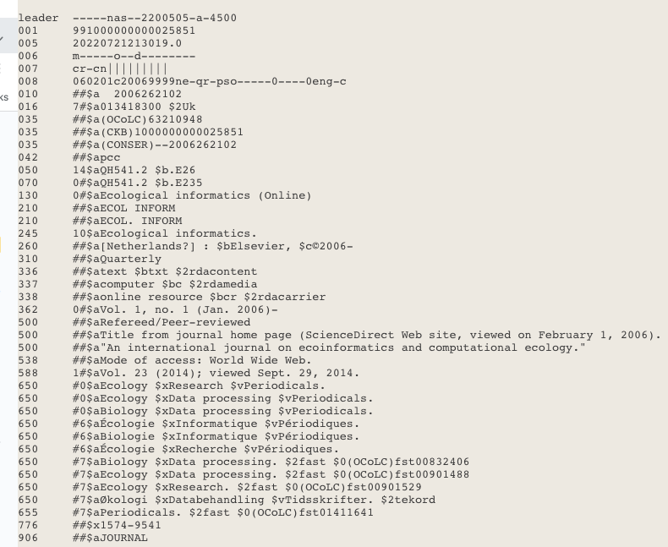
How Different?
Manually created
Human-readable
Require some work to be parsed
Machine and human-readable
No specific standard
Automatically created
Machine and human-readable
Machine and human-readable (web version)
Follows a metadata standard (MARC)

Slide 15
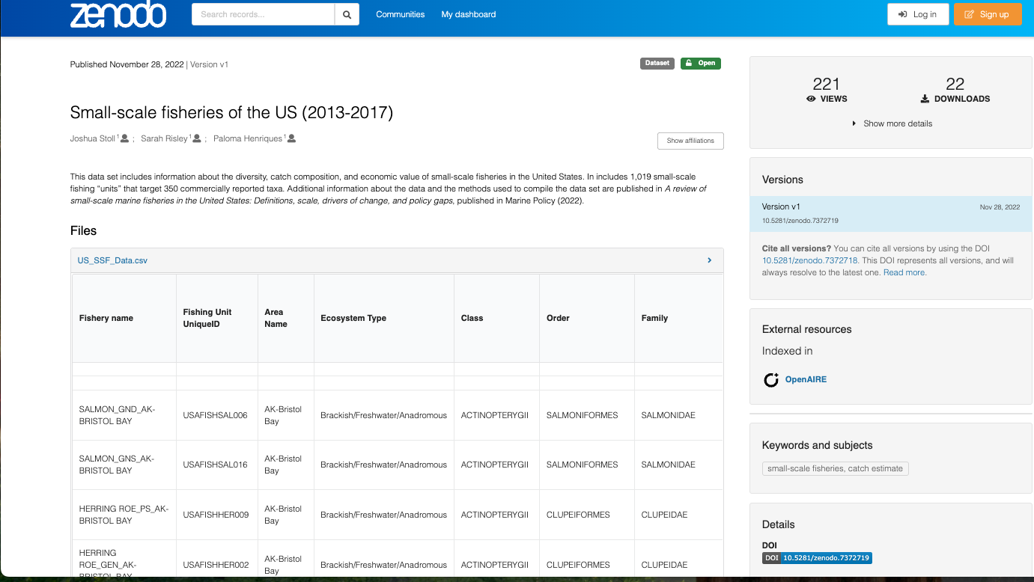
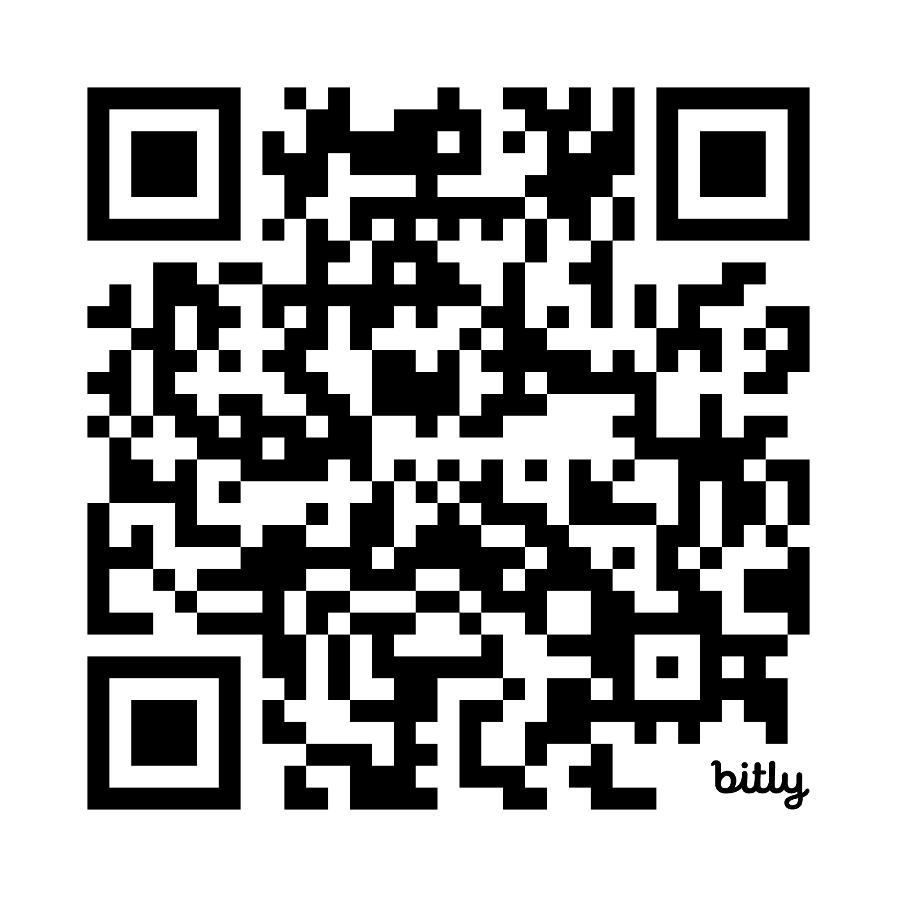
Opportunities for Improvement?
https://zenodo.org/records/7372719

Slide 16


Slide 17
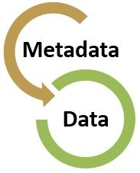
Metadata Best Practices
Keep data entry consistent
Define the parameters and the units on the parameter
Explain the formats for dates, time, geographic coordinates, and other parameters
Define any coded values
Describe quality flags or qualifying values
Define missing values
Choose an established metadata standard

Slide 18
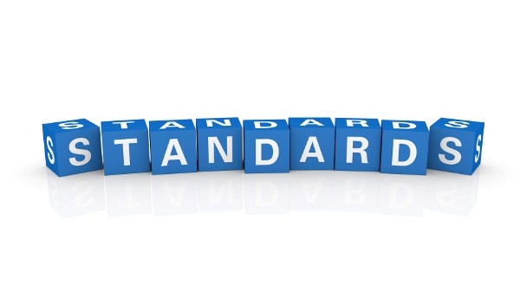
Metadata Standard
Establishes a common way of structuring and understanding data, and includes principles and implementation issues for utilizing the standard.
Provides a structure to describe and retrieve data!
Common terms to allow consistency between records
Common structure to quickly locate components
Reliable and predictable format for computer interpretation
A uniform summary description of the dataset

Slide 19
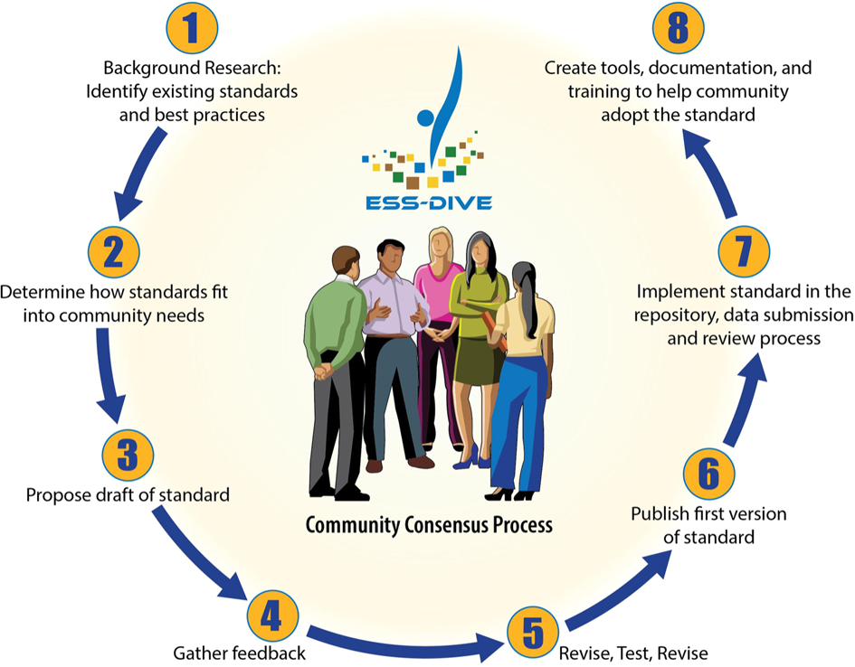
Community-Centric Initiatives
Guidelines & Templates
Metadata Crosswalks
Archiving Requirements (Repository)
Crystal-Ornelas, R., Varadharajan, C., O’Ryan, D. et al. Enabling FAIR data in Earth and environmental science with community-centric (meta)data reporting formats. Sci Data 9, 700 (2022). https://doi.org/10.1038/s41597-022-01606-w

Slide 20
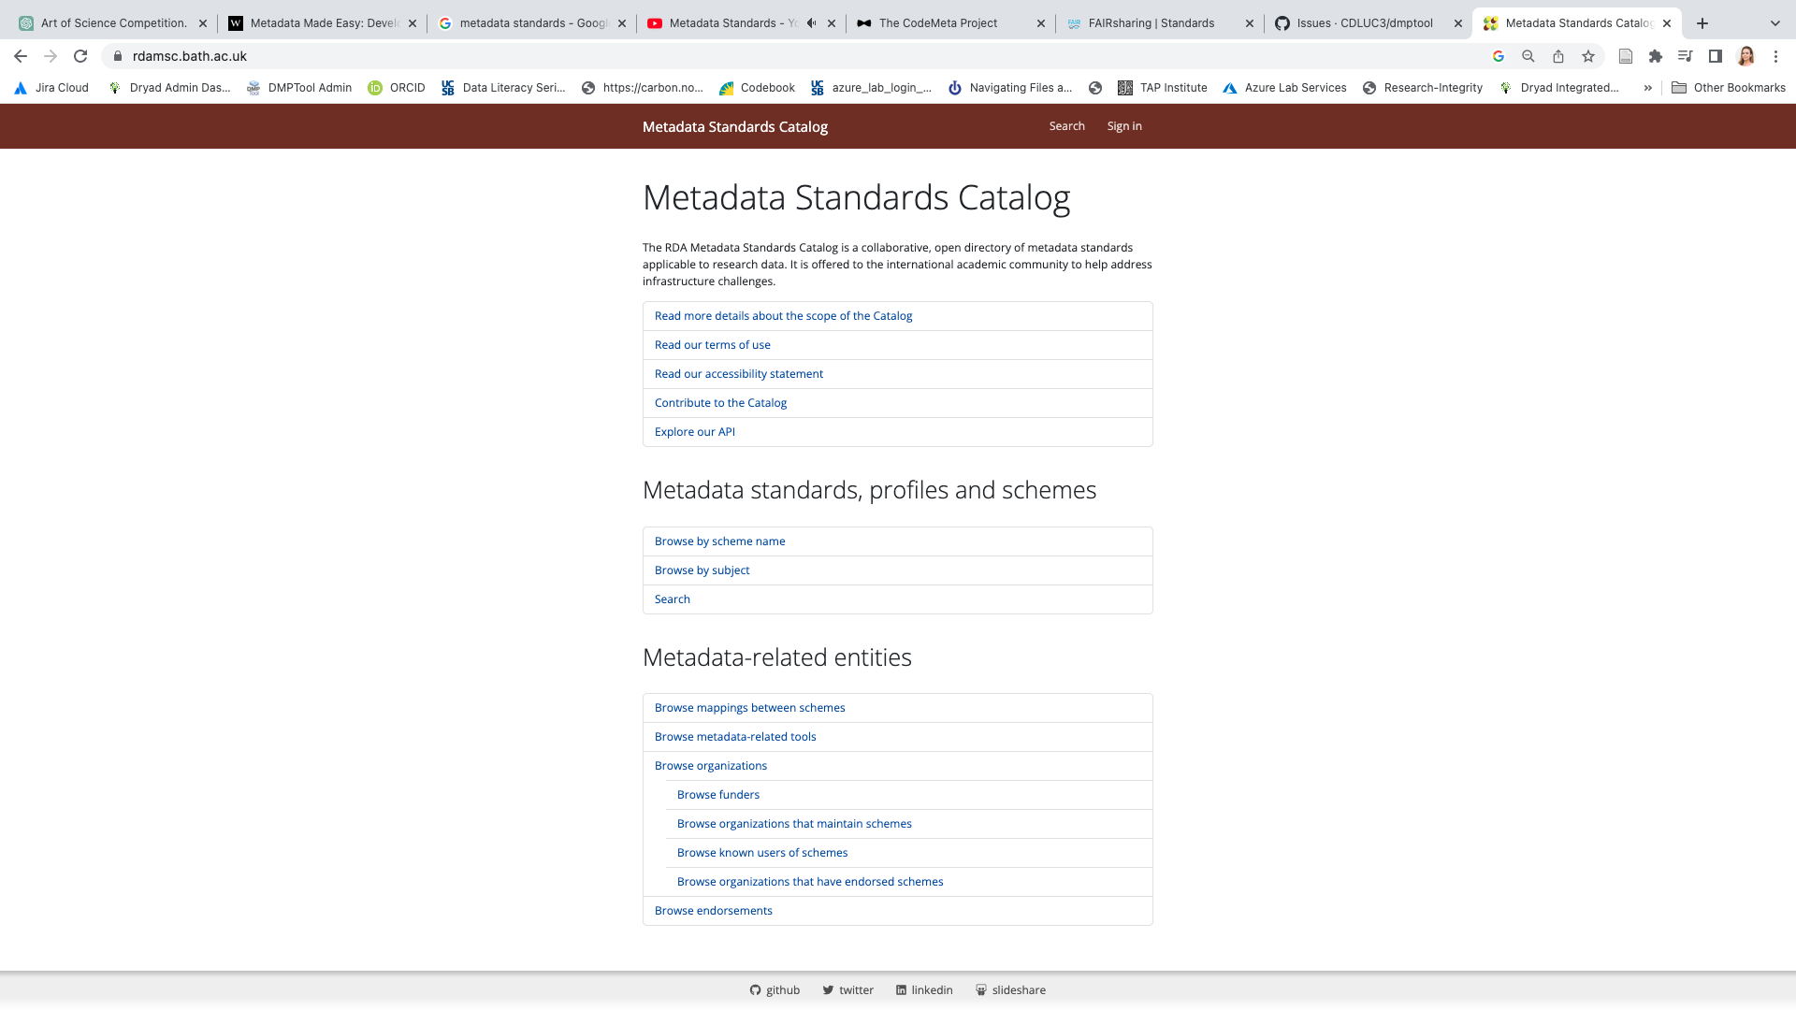
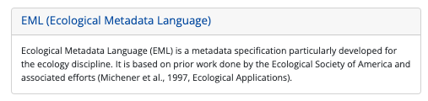
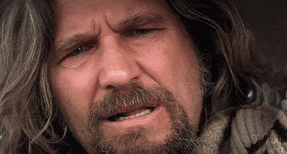
Which Metadata Standard?
https://rdamsc.bath.ac.uk

Slide 21
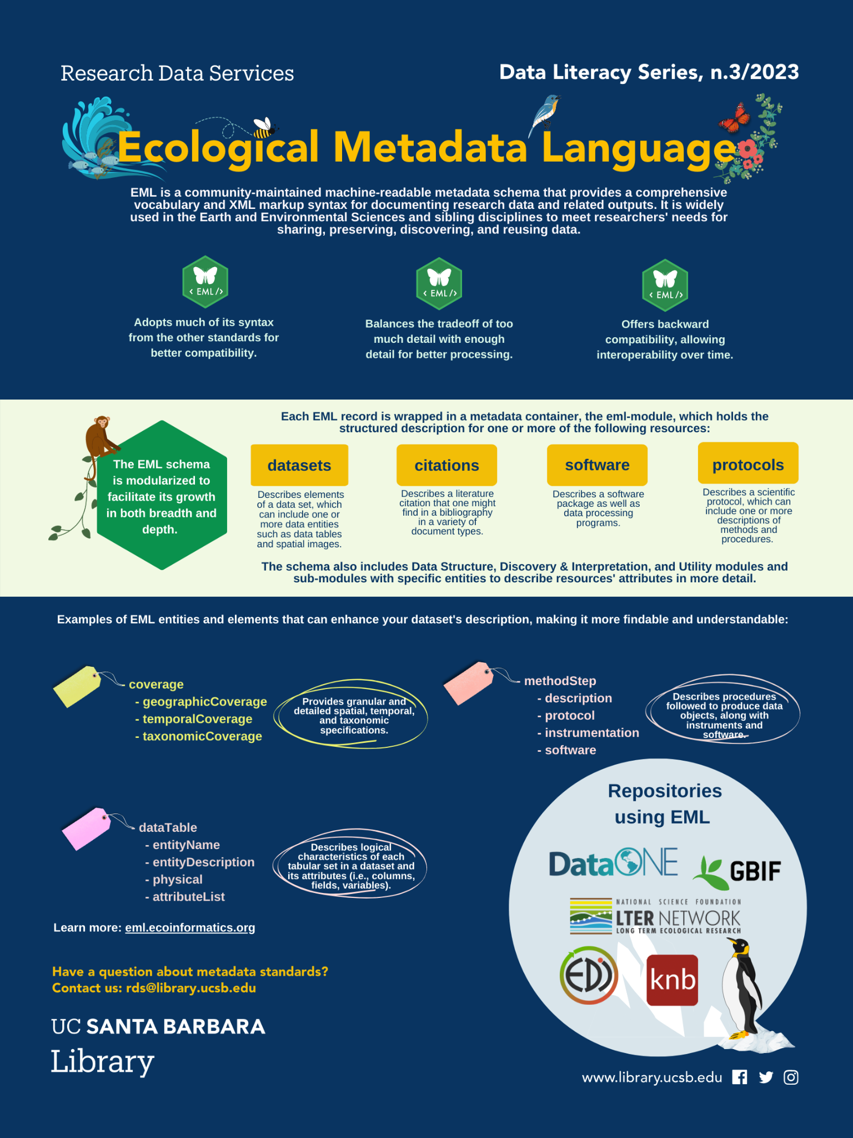
Current version EML 2.2.0
Developed at NCEAS
Compatible with other standards (DCMI, CSDGM/FGDC, ISO19115 )
A “dialect” for XML
Modular
Detailed structure
Requires validation
Uses tags aligned with the requirements and needs from the ecology and environmental community
Used by some of the most relevant data repositories in the field
https://eml.ecoinformatics.org/

Slide 22

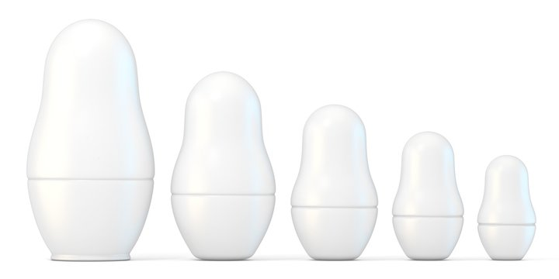

EML in XML
Flexible language used to define and structure data using custom tags.
Tags are readable and descriptive, making XML easy to understand for both humans and computers.
Data is organized in a nested format (like Russian dolls), clearly showing relationships between elements.
The consistent structure makes XML ideal for sharing and transforming data across systems.
XML does not perform computations; it’s purely for describing data, not processing it.
EML Record
Dataset
Data Table
Attribute
List
Attribute

Slide 23
A good enough EML record
- eml
- dataset
- title*
- creator(s)*
- publisher
- pubDate
- keywords
- abstract
- intellectualRights
- contact*
- methods
- coverage (e.g., geographic/temporal/taxonomic)
- dataTable
- entityName
- entityDescription
- physical
- attributeList
*A minimum valid record (but not as useful)

Slide 24
Creating an EML Record
Simple text editor (e.g., Atom) - painful! Only recommended for small edits. Not for creating a whole record.
EzEML (EDI Web Form) - GUI for non-tech people, useful tool, but can be time consuming, lots of clicks!
An EML R package for you’all data-savys!

Slide 25
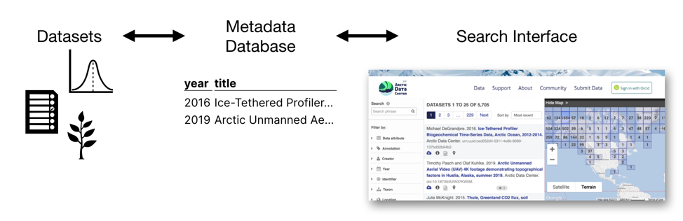
Metadata Standard in Action
Granular Search
More attributes of data become visible and searchable, while also maintaining greater consistency
https://www.nceas.ucsb.edu/news/why-you-never-knew-how-much-you-needed-ecological-metadata-language

Slide 26
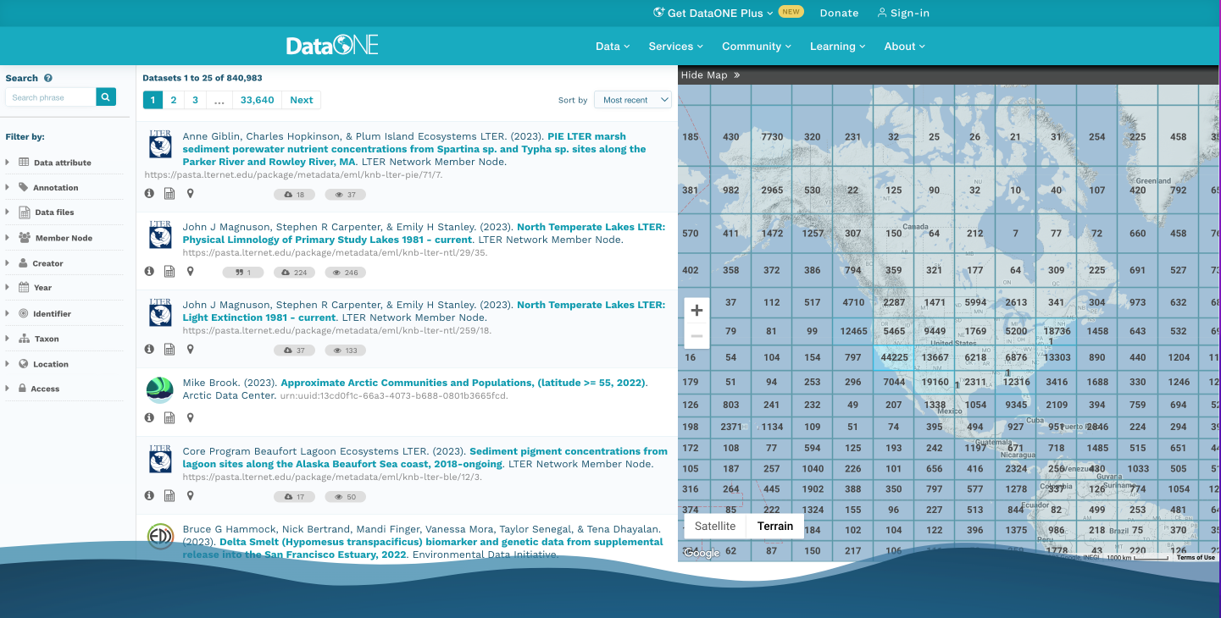
Metadata Standard In Action https://search.dataone.org/data

Slide 27
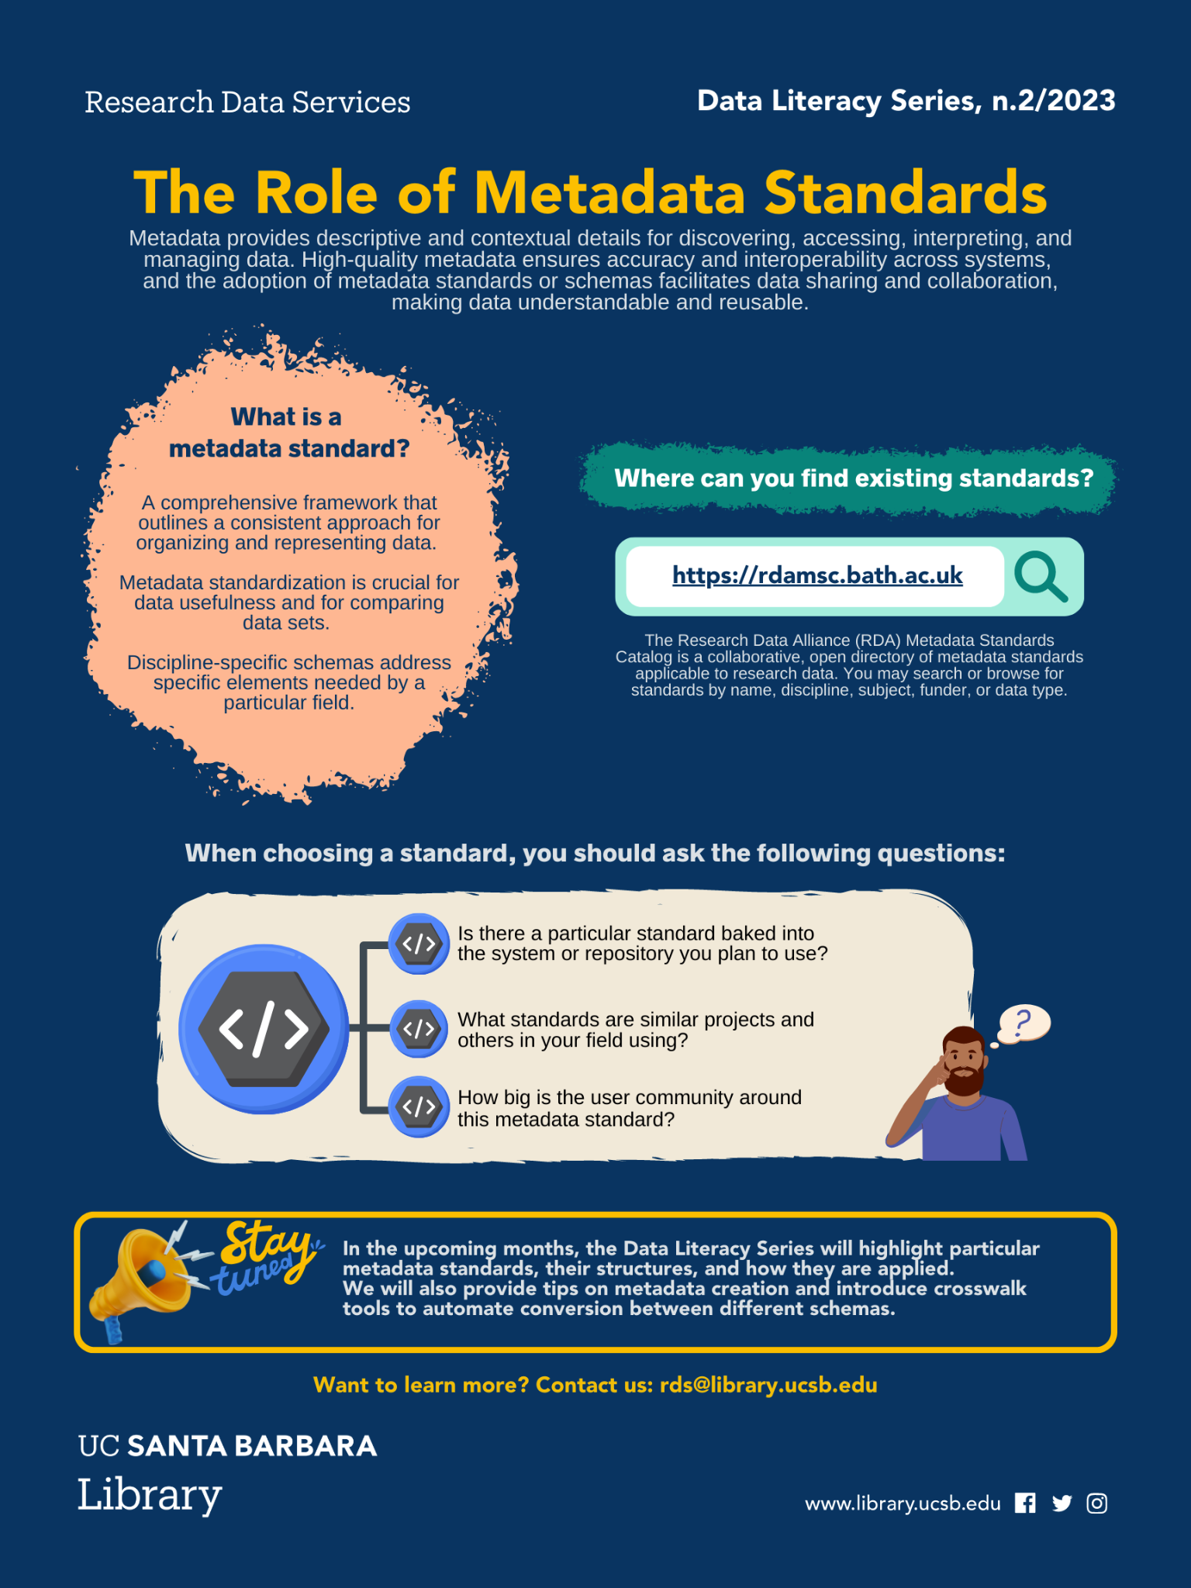
Choosing a Metadata Standard
Is there a particular standard baked into the system or repository you plan to use?
What standards are similar projects and others in your field using?
How big is the user community around this metadata standard?

Slide 28
Recapping
Machine and human-readable metadata are essential for describing digital objects like datasets.
Without standard formats, inconsistent metadata hinders data discovery, comparison, and integration.
Standards like EML enable efficient data management and promote interoperability.

